Slide 1
Indexes

Slide 2
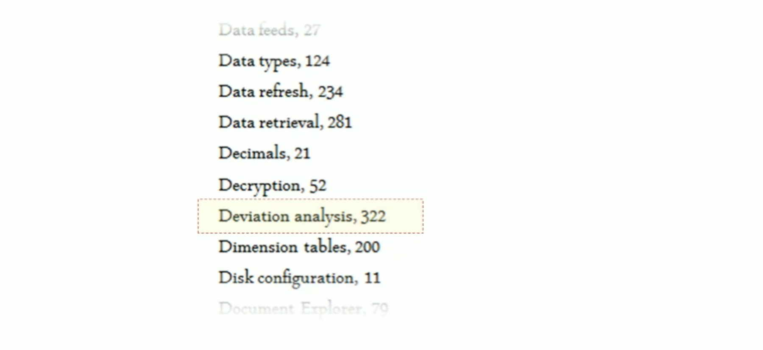
The concept

Slide 3
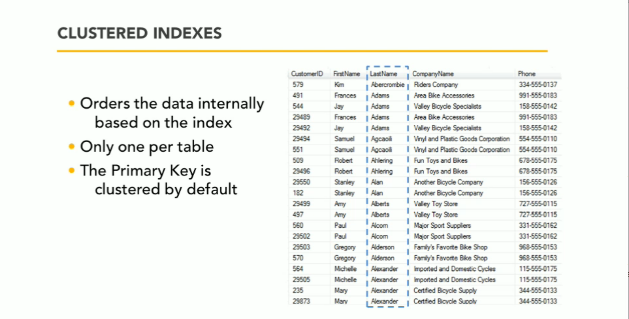
Clustered index

Slide 4
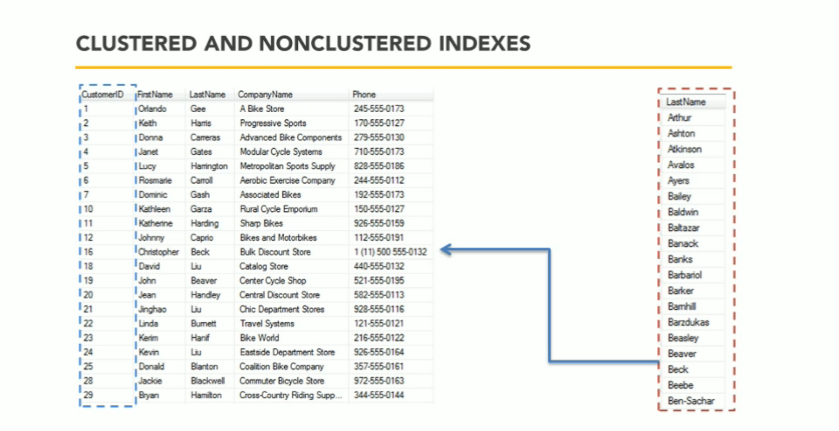
Non-clustered index…

Slide 5
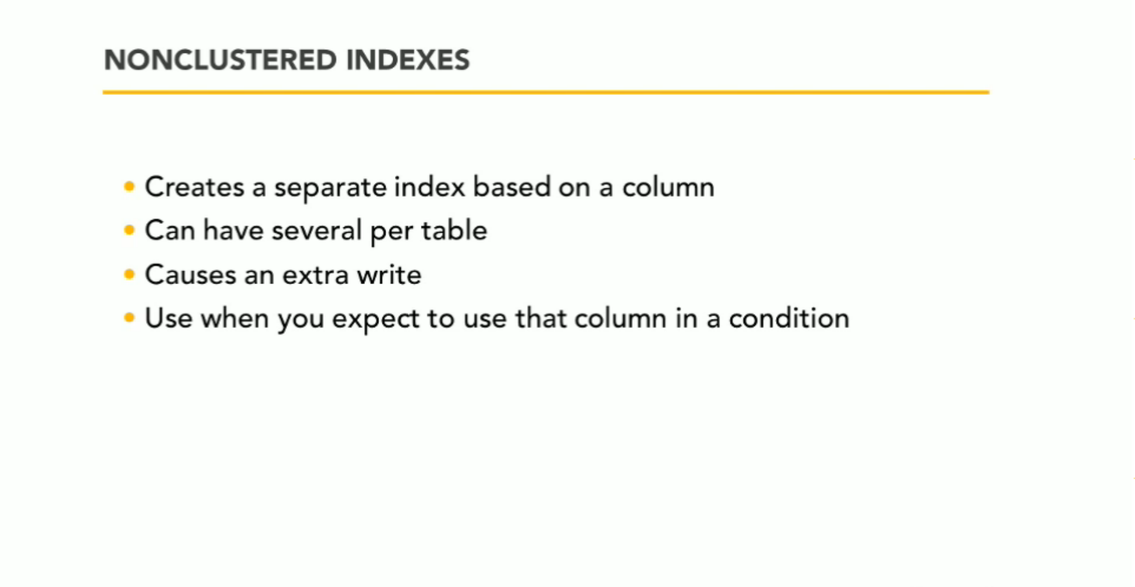
Non-clustered index

